Slide 1
Entity Object
(Section 1 - 2)

Slide 2
Ingredients of an entity object
Entity Definition
Entity Collection(Entity Cache)
Entity Object
Association
Entity Object

Slide 3
Core features of ADF entity objects
Visual and declarative development
Associations
Declarative validation
Entity inheritance
Entity caching
Built-in CRUD operations
Concurrency handling
Customizable framework components
Domain-driven development
Security-enabled business components

Slide 4
Accessing the resource bundle from the entity object class
To access the resource bundle defined for the entity object from the entity object implementation class:
//Access the ResourceBundleDef defined for the entity object
ResourceBundleDef resourceDef = this.getResourceBundleDef();
//Get the user locale
Locale locale = this.getDBTransaction().getSession().getLocale();
//Get the localized value for the key
String retVal = StringManager.getLocalizedStringFromResourceDef(resour
ceDef, key, null, locale, null, false);

Slide 5

Property set
There are a number of predefined properties for an attribute in an entity object. Sometimes you may wish to add custom properties for the attributes to store other information and create custom behavior at runtime.
Translatable messages such as attribute labels, short description, and other UI control hints.
No translatable key value properties used in the business logic implementation.
Creating a property set
Associating the property set with the entity object attributes

Slide 6
Using custom properties in business logic
The following example illustrates how you can use custom properties associated with an entity attribute in the business logic.
public class EmployeeEOImpl extends EntityImpl {
public void setEmail(String value) {
boolean updateAllowed = true;
String emailUpdateCheckEnforced = (String)getDefinitionObject()
.getAttributeDef(EMAIL).getProperty("UPDATE_CHECK_ENFORCED");
if (("true".equals(emailUpdateCheckEnforced)))
updateAllowed = isEmailUpdatable();
if (updateAllowed)
setAttributeInternal(EMAIL, value);
}
}

Slide 7
Effective dated entity objects
Effective dated entities are used to provide a view into the dataset pertaining to a specific point in time.
Click on the desired attribute and set it as effective start date, either using the Start Date drop-down list in the Property Inspector window, or using the Start Date radio button in the overview editor. Similarly select another attribute in End Date. Make sure you are marking the start and end dated attributes as Keys.
The runtime behavior of effective date handling is controlled by the effective date mode set for the effective dated entity. The following code snippet sets the effective date mode as EFFDT_UPDATE_CHANGE_INSERT_MODE :
empEntityImpl.setEffectiveDateMode(Row.EFFDT_UPDATE_CHANGE_INSERT_MODE);
empEntityImpl.setSalary(10000);
getDBTransaction().commit();

Slide 8
Effective dated entity objects Update Modes
EFFDT_UPDATE_CORRECTION : the effective start date and effective end date is left unchanged. No new rows are created to track the update.
EFFDT_UPDATE_MODE : the modified row is end dated on the effective date and a new row is created with the changed values. The effective start date of the new row is set to effective date + 1 day and effective end date is set to end of time.
EFFDT_UPDATE_OVERRIDE_MODE : the modified row is end dated on the effective date and the start date of the next row in the effective date time line is set to effective date + 1 day.
EFFDT_UPDATE_CHANGE_INSERT_MODE : the modified row is end dated on the effective date and a new row is inserted that fits between the effective date and the start date of the next row in the effective date time line.
EFFDT_UPDATE_NEW_EARLIEST_CHANGE_MODE : Updating in "new earliest change" mode is supported only in Multiple Changes Per Day. It allows creation of a new earliest change in a day.

Slide 9
Effective dated entity objects Delete Modes
EFFDT_DELETE_MODE : the end date of the row is set to the row's effective date and all the future rows for the same key values are deleted. The DML operation on the row that was actually removed would be an update whereas for the future rows it would be a delete.
EFFDT_DELETE_THIS_CHANGE_MODE : the current row is removed. If a prior row exists, its end date is set to current row's end date.
EFFDT_DELETE_NEXT_CHANGE_MODE : the end date of the row is set to the end date of adjoining row and the adjoining row is deleted. The DML operation on the row that was actually removed would be an update whereas for the adjoining row it would be a delete.
EFFDT_DELETE_FUTURE_CHANGE_MODE : the end date of the row is set to the end of time and all the future rows for the same key values are deleted. The DML operation on the row that was actually removed would be an update whereas for the future rows it would be a delete.
EFFDT_DELETE_ZAP_MODE : When an effective dated row is deleted in "zap" mode, all the effective dated rows with the same key values are deleted.

Slide 10
Inheritance hierarchies in entity objects
ADF entity objects use a single table per hierarchy approach while implementing multiple inheritances. Child entities can be mapped to extra columns from the same table, if needed.
The polymorphic discriminator type is introduced to simulate inheritance hierarchies in entity and view objects.
Each entity in the hierarchy will have a different value for each polymorphic discriminator attribute and run time will use this value to identify rows for each entity in the hierarchy.

Slide 11
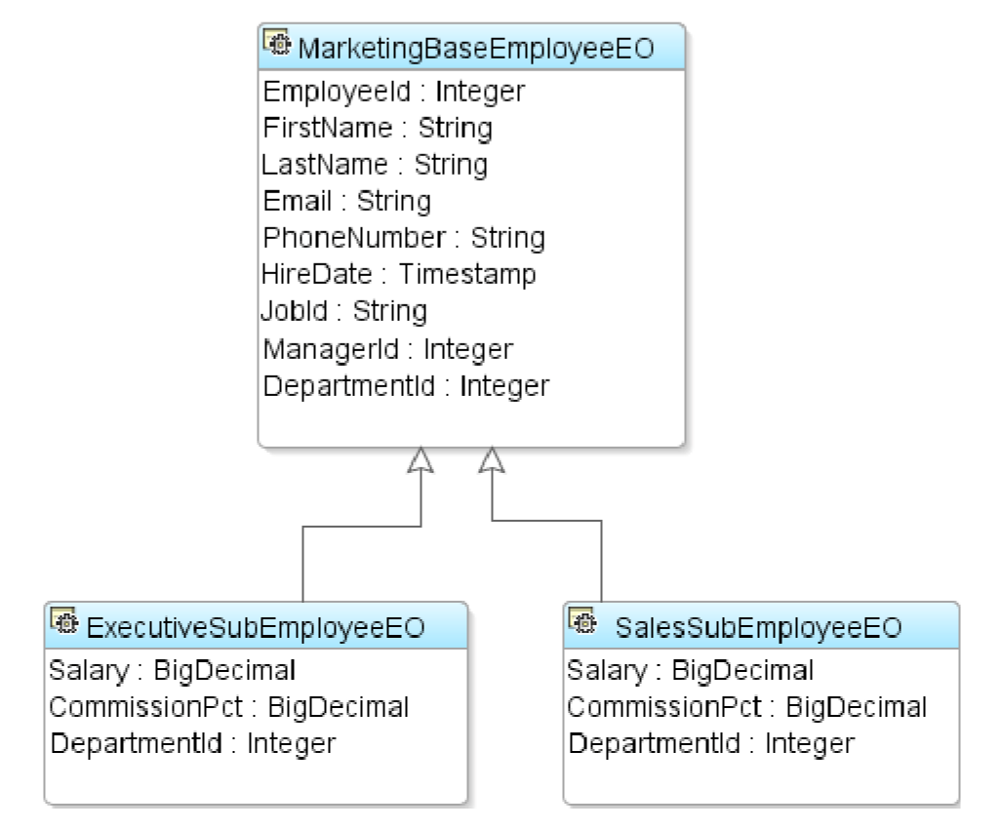
Inheritance hierarchies in entity objects
Creating inheritance hierarchies for entity objects
When you execute a view object built by using an entity, which acts as a base entity in the hierarchy, the framework will not try to add any special WHERE clause to reflect the discriminator attribute values of the entity object. The filtering based on the discriminatory attributes happens later in the execution cycle

Slide 12
Inheritance hierarchies in entity objects
While finding entities in a hierarchy by using primary key, if you also want to include subtypes in search, use the findByPKExtended() method from the EntityDefImpl class:
EntityImpl empEOImpl = empBaseEODef.findByPKExtended(getDBTransaction(), empIdKey, true);

Slide 13
Specifying custom properties
This option will help you to define custom properties that the entity object can access at runtime. This is conceptually similar to the properties used in Property Set that we discussed earlier in this chapter. But the custom properties defined in entity object are local to the entity object.

Slide 14
Concurrent access and locking
When many users work on the same business data simultaneously, it is necessary to ensure that the concurrent business transactions do not overwrite the other user's changes inadvertently.
Configuring Locking Mode for an ADF application
Per application module level: Open the application modules in the editor .Edit configuration .Click on the Properties tab and modify jbo.locking.mode to the desired value.
Application level: In adf-config.xml file in the ADF META-INF folder in the Application Resources under the Descriptors panel view in Application Navigator.

Slide 15
Concurrent access and locking
Supported values for jbo.locking.mode are as follows:
None: No locking is done when the user updates a row.
Pessimistic: This mode will try to lock an entity instance in advance before allowing any changes by explicitly firing SELECT FOR UPDATE on the underlying database row, and the row will remain locked till you commit the transactions.
Optimistic: This mode will try to lock the entity before posting modified data to the database, followed by a check for stale data.
Optupdate: This mode will not issue lock on the row, it will just see if all row attributes that are participating in the update have the latest value from the database table.

Slide 16
Concurrent access and locking
Supported values for jbo.locking.mode are as follows:
None: No locking is done when the user updates a row.
Pessimistic: This mode will try to lock an entity instance in advance before allowing any changes by explicitly firing SELECT FOR UPDATE on the underlying database row, and the row will remain locked till you commit the transactions.
Optimistic: This mode will try to lock the entity before posting modified data to the database, followed by a check for stale data.
Optupdate: This mode will not issue lock on the row, it will just see if all row attributes that are participating in the update have the latest value from the database table.

Slide 17
Concurrent access and locking
Example :
//Find the employee entity using ID
EmployeeEOImpl empEO= findEmployeeById(1000) ;
//Modifies the entity name
empEO.setName("John");
//Commit the transaction
getTransaction().commit();

Slide 18
Concurrent access and locking
empEO.setName("John");
When an attribute is modified, the framework will check the locking mode to take appropriate actions.
If the locking mode is pessimitic, ADF Business Components runtime performs the following steps:
Executes SELECT FOR UPDATE NOWAIT on the underlying database row to acquire lock.
Checks if the originally retrieved values of the entity attributes are the same as the values in the database.
The framework will not attempt to lock the row for other locking modes during this stage.

Slide 19
Concurrent access and locking
getTransaction().postChanges();
getTransaction().commit();
If the locking mode is optimistic or optupdate, the concurrency handling happens at this stage.
If the lock mode is optimistic, the ADF Business Components runtime performs the following steps:
Executes SELECT FOR UPDATE on the row for the entity to acquire lock.
Checks if the originally retrieved values of the attributes are the same as the values in the database.
If the lock mode is optupdate, the framework does not explicitly lock any database row. ADF Business Components runtime generates UPDATE with the WHERE clause to ensure that the update is not happening on stale data.

Slide 20
Enabling a batch update in an entity object
The batch update facility allows multiple update operations to be submitted to a datasource for processing at once. If a use case demands an update on multiple instances of the same entity in a single transaction, the update batching can be turned on for the entity. This feature works with Oracle database.
Please be warned that entity refresh features such as Refresh on Update and Refresh on Insert may not work in batch update mode.

Slide 21
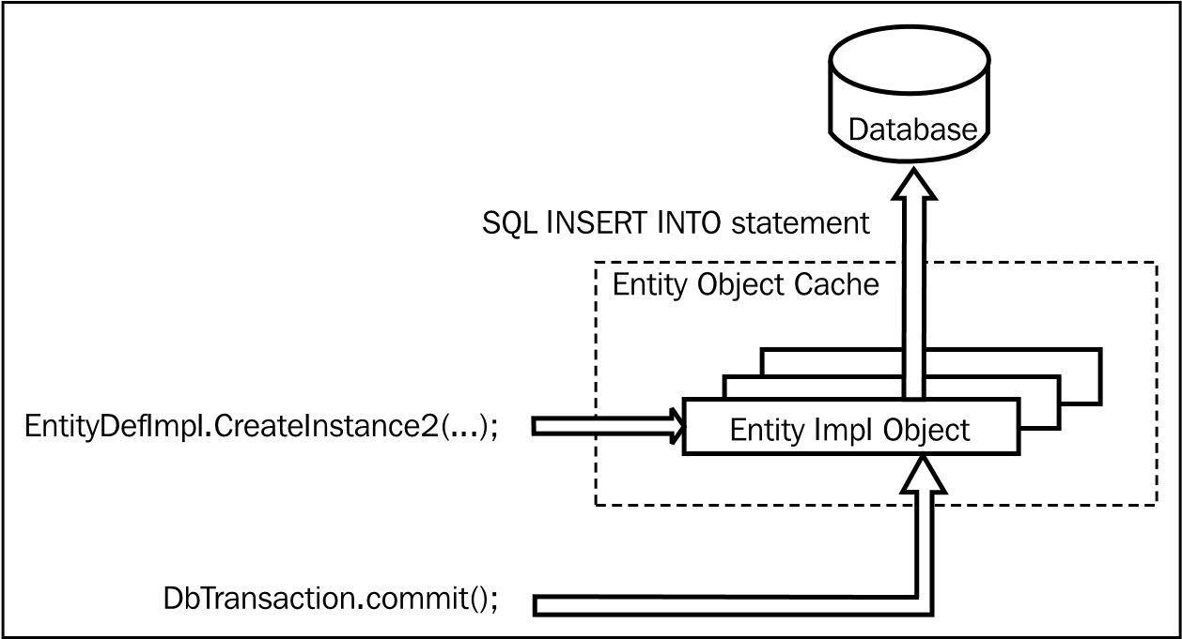
Programmatically creating an entity instance

Slide 22
Entity object in a transaction post cycle
//Get the Entity Definition
EntityDefImpl empEODef = EmpEOImpl.getDefinitionObject();
//Generate Key using empId parameter
Key empIdKey = EmpEOImpl.createPrimaryKey(new Integer(empId));
//Find Emp entity using Key
EmpEOImpl empEO= (EmpEOImpl) empEODef.findByPrimaryKey(getDBTransaction(), empIdKey);
//Update the attribute
empEO.setFirstName(“Fanous");
//Commit transaction
getDBTransaction().commit();

Slide 23
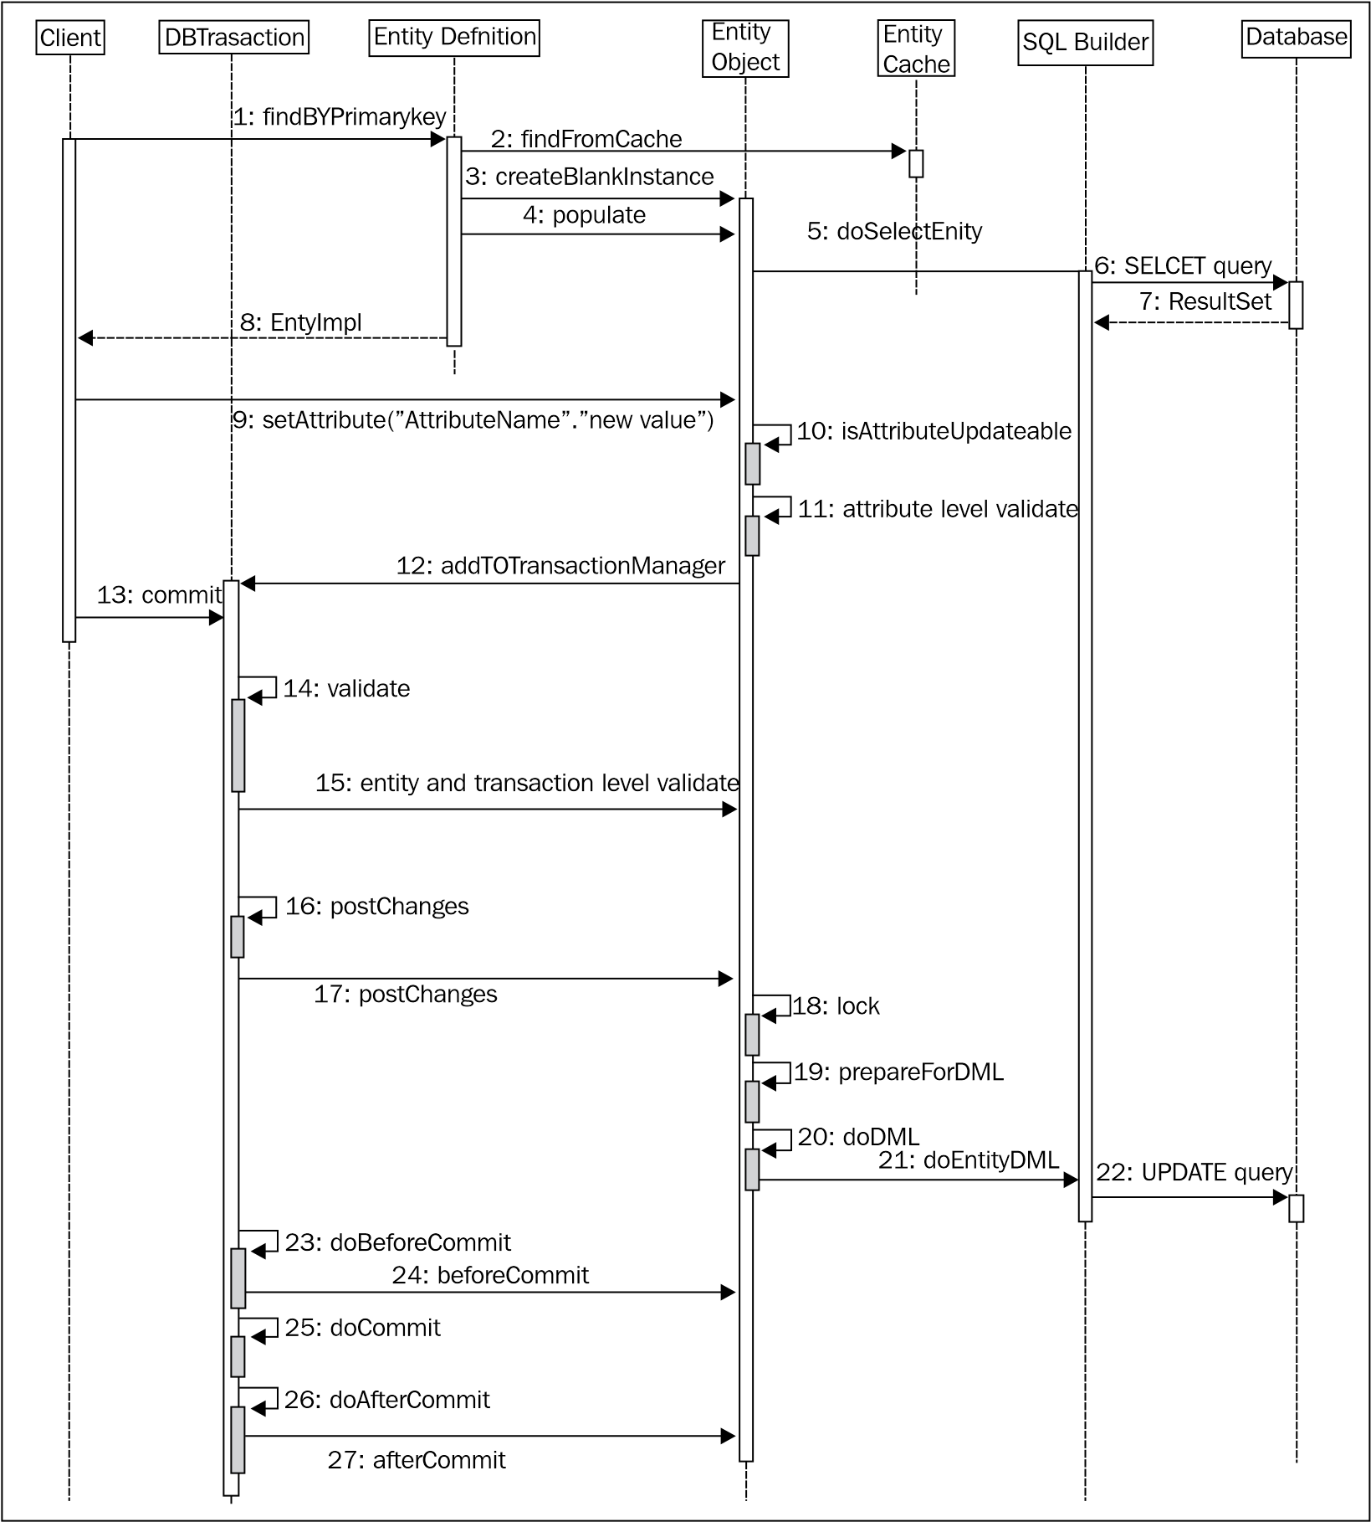
Entity object in a transaction post cycle

Slide 24
Entity object in a transaction post cycle

Slide 25
Entity object in a transaction post cycle
The client retrieves the entity object, calling findByPrimaryKey() on an entity definition by passing a key object. First, the framework will check the entity cache for the entity, and if not found, the SQL SELECT query will be fired to read the row from the database. An example is as follows:
Native SQL generation for ADF business components is done by the SQLBuilder implementation class.
The entity cache will be updated with the retrieved entity instance and the status will be marked as Unmodified. The client receives the retrieved instance.
In the next step in this example, the client updates an attribute by calling setter on the entity instance.If the attribute value is modifiable, the new value will be validated and passed on to the entity. The entity status is transitioned into Modified.
oracle.jbo.server. DBTransactionImpl2 is the default configured transaction manager for business components. It maintains three lists to carry out the transaction commit cycle:
Validation listener list
Transaction post listener list
Transaction listener list

Slide 26
Entity object in a transaction post cycle
When the program commits the transaction:
The transaction manager validates all the entries from the validation listener list by calling validate() on each listener, which includes dirty entities as well. This will validate all the entity level validations that you have added.
The next phase is posting data to the database. The transaction manager iterates through the transaction post listener list and calls postChanges() on each item. The data post for an entity happens in multiple steps:
Lock the entity
Prepare the entity for DML: The prepareForDML() method is called on the entity and it performs all the preparation prior to posting data to the database. This includes updating history columns .
Post data to database: The doDML() method generates appropriate native SQL statement to perform INSERT, UPDATE, or DELETE processing for the row.
Commit the transaction. The transaction manager will invoke beforeCommit() on each element in the transaction listener list. Then it commits the transaction and if successful, afterCommit() is called on each item in the transaction listener list. The entity object's state will be reset back to Unmodified in the afterCommit() method.

